Slide 1

The Final Project NoCode University
by Anastasiia Petrova

Slide 2
Introduction
Former tourism worker with 8 years of experience in this field
Now work as Quality Control Engineer
Knowledge in: Java, HTML, MySQL, GitHub;;
QA tools and technologies: Jira, Postman;
Automated test cases with Maven, Selenium, Gradle, Selenide, Cucumber on IntelliJ IDEA;
Languages: Russian, Ukrainian (C1), English (C1), and German (B2)

Slide 3
Project tasks
familiarization with the documentation and the features on the website;
exploratory tested the system;
decomposed existing requirements and made a mindmap with Qase.io;
created manual test cases;
discovered and created bug reports;
automated some of the created manual test cases;

Slide 4
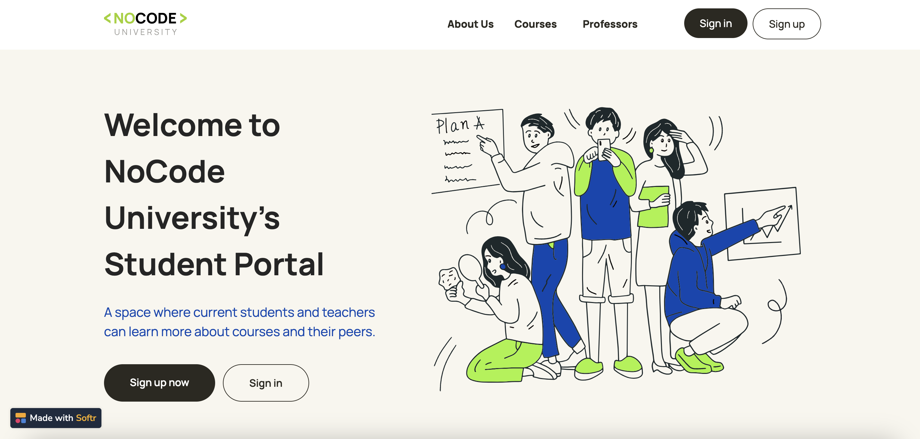

Slide 5
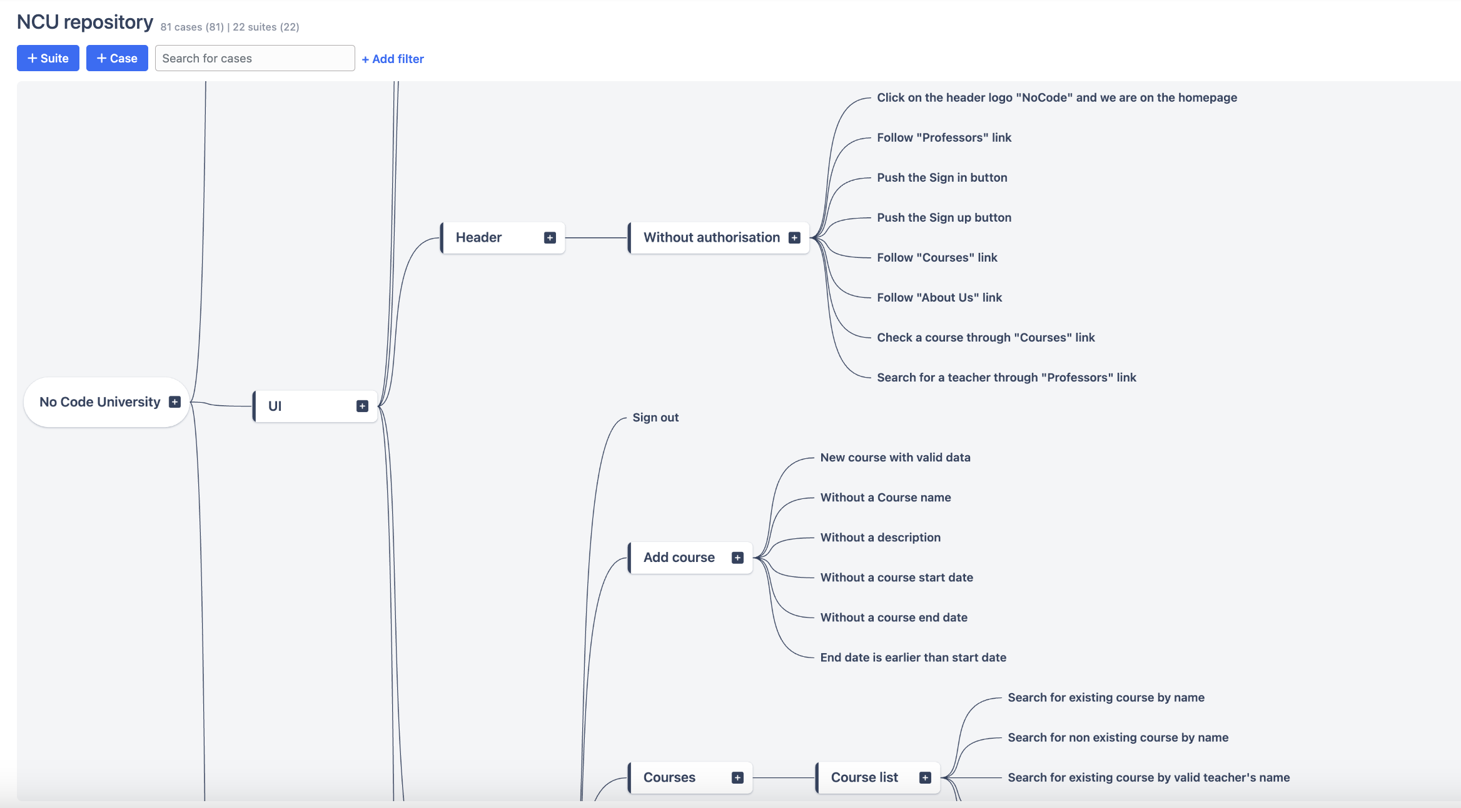

Slide 6
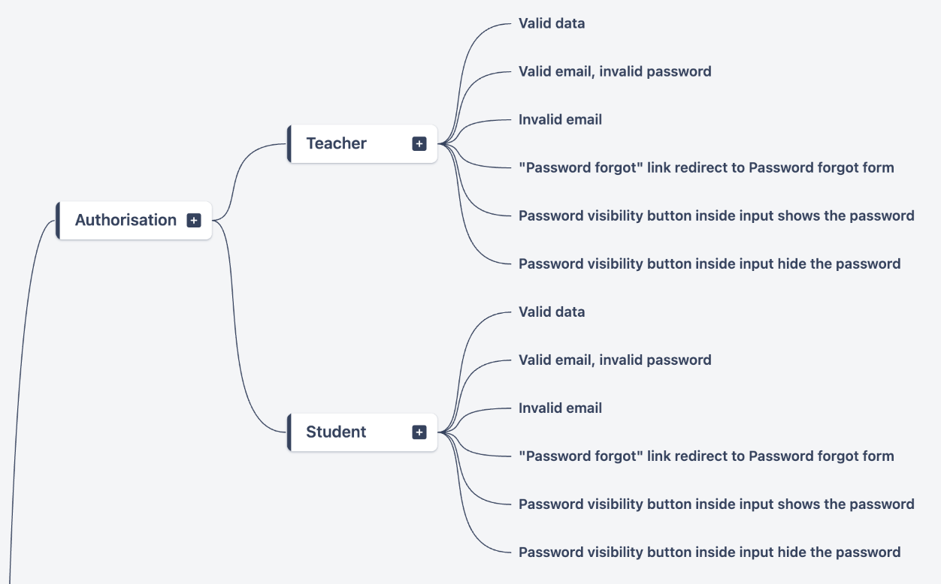
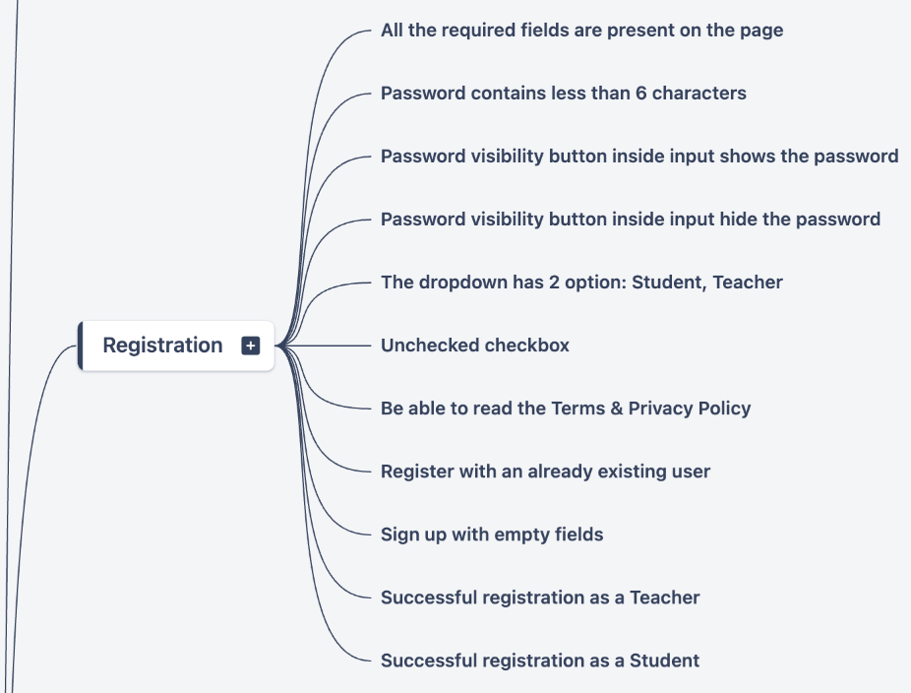

Slide 7
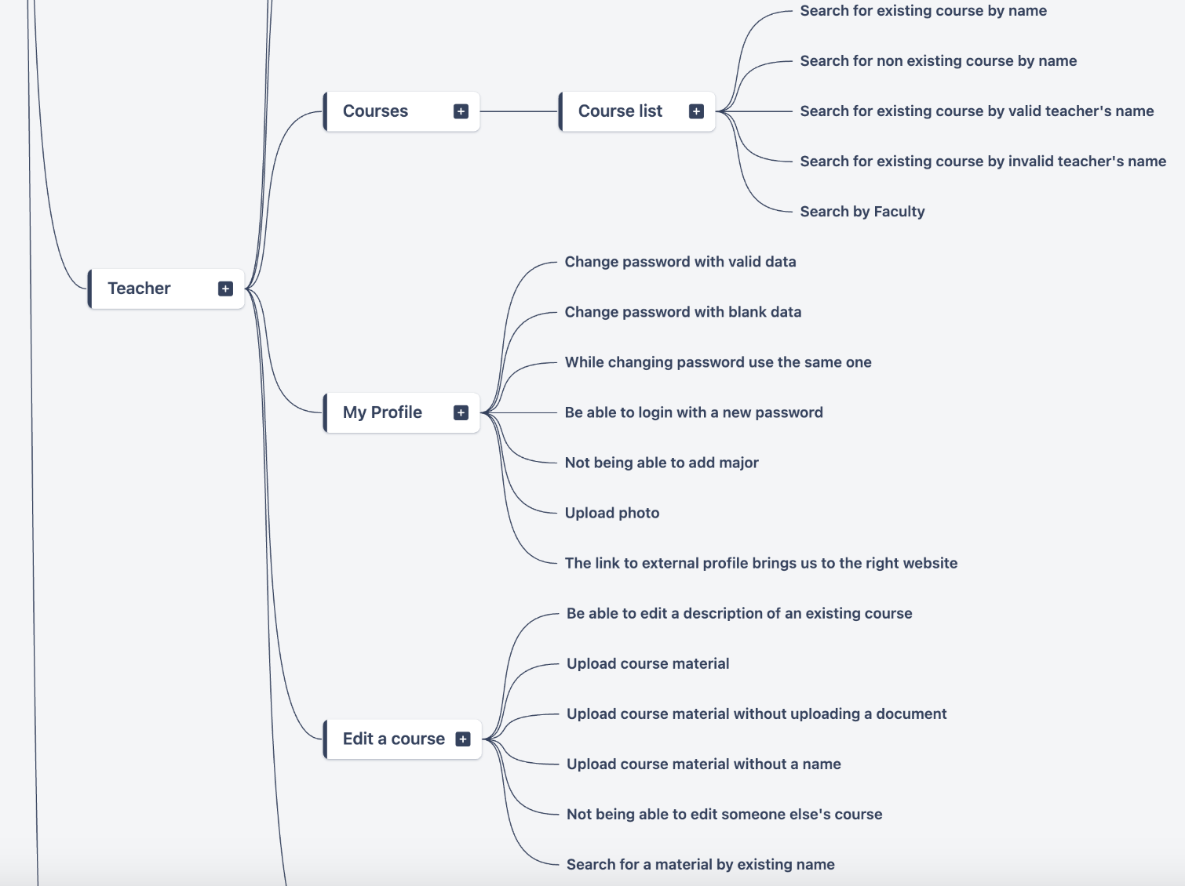
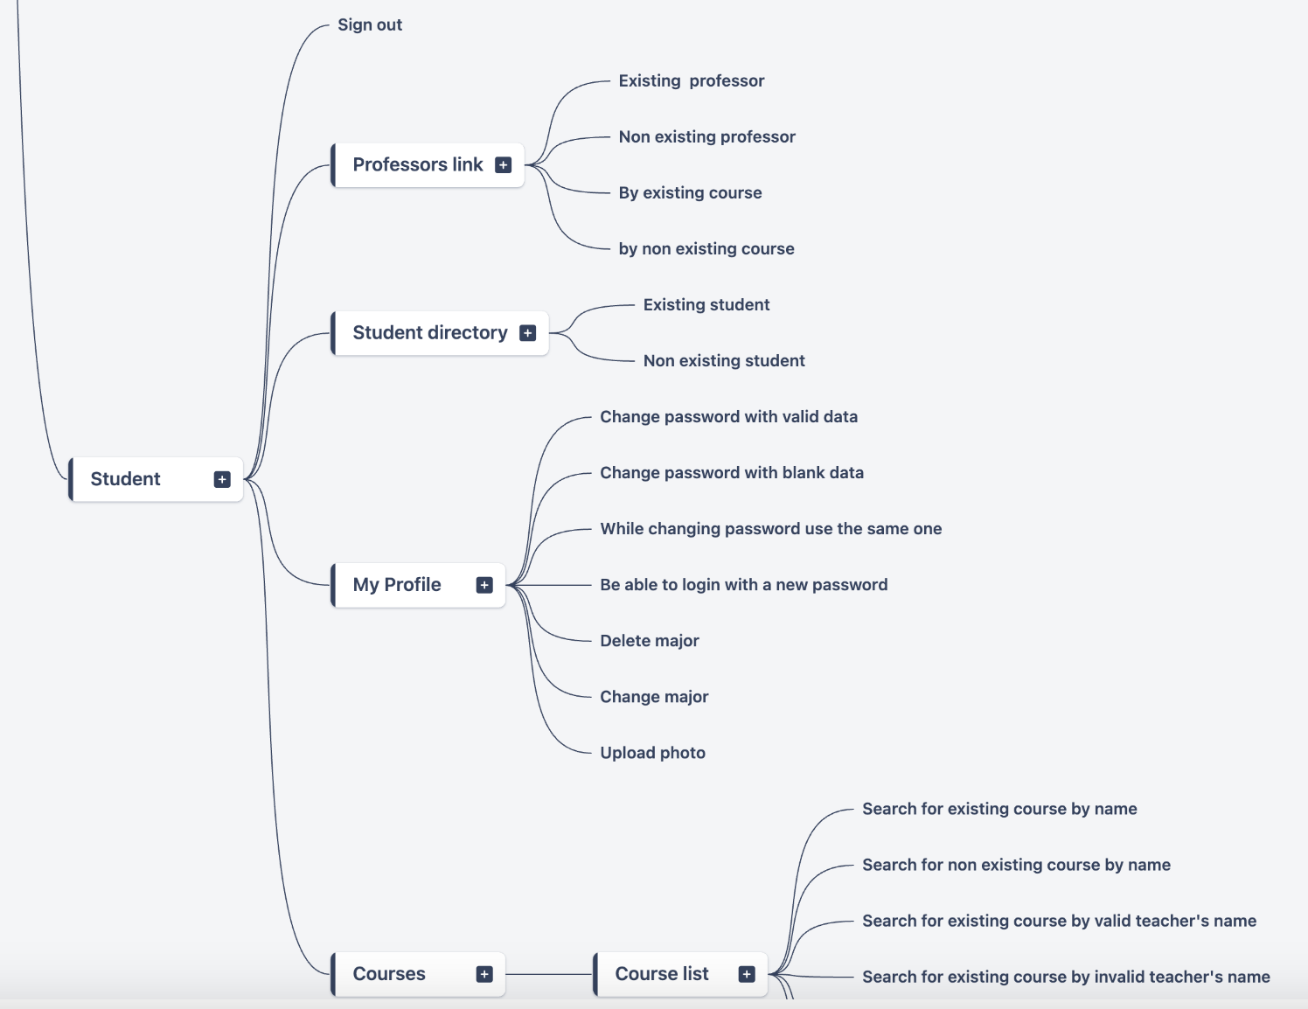

Slide 8
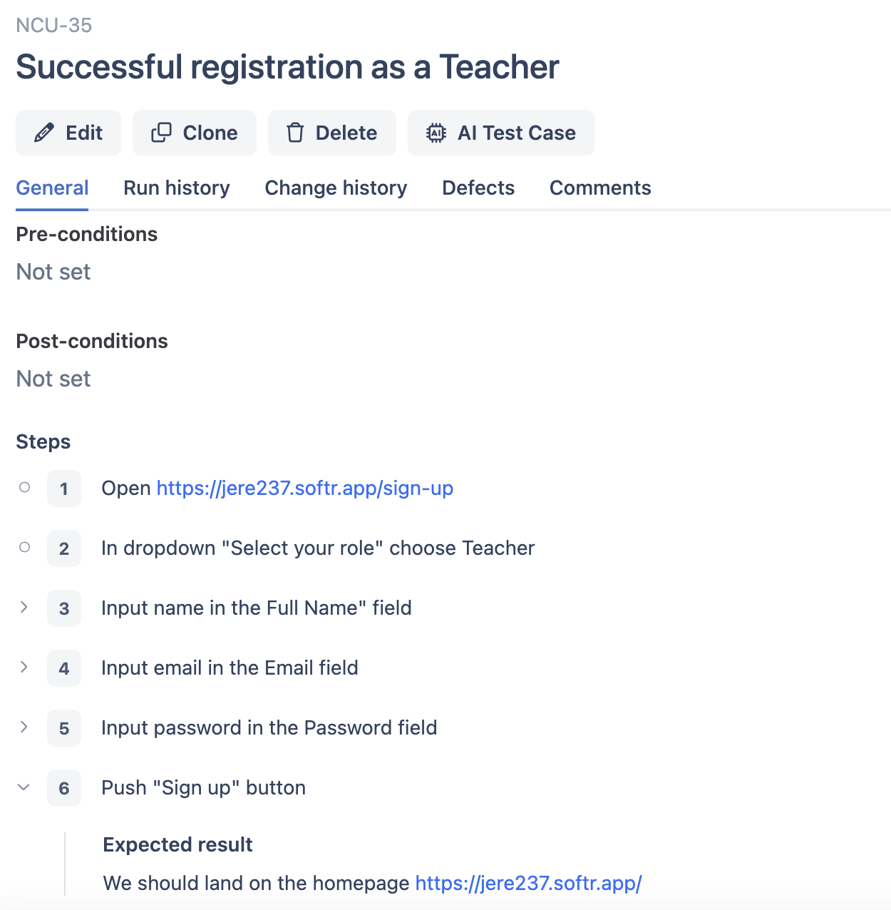
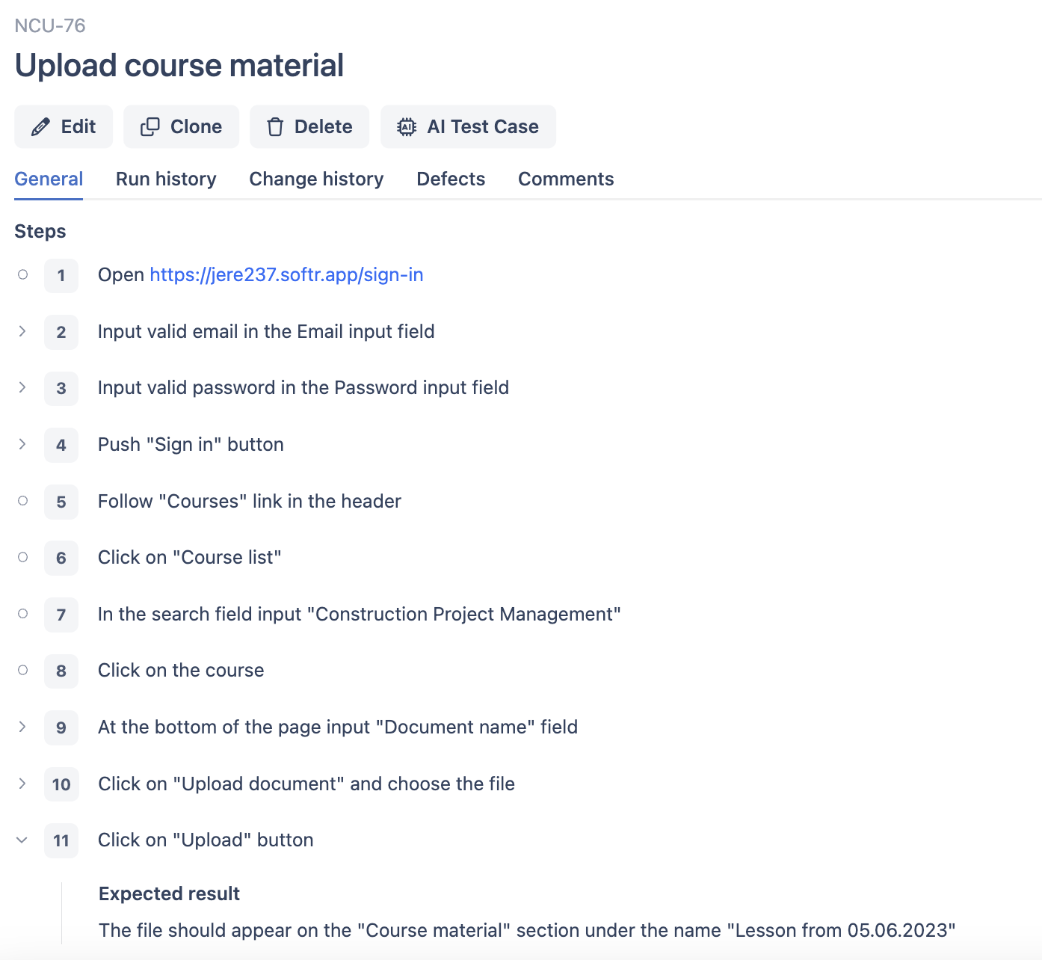

Slide 9
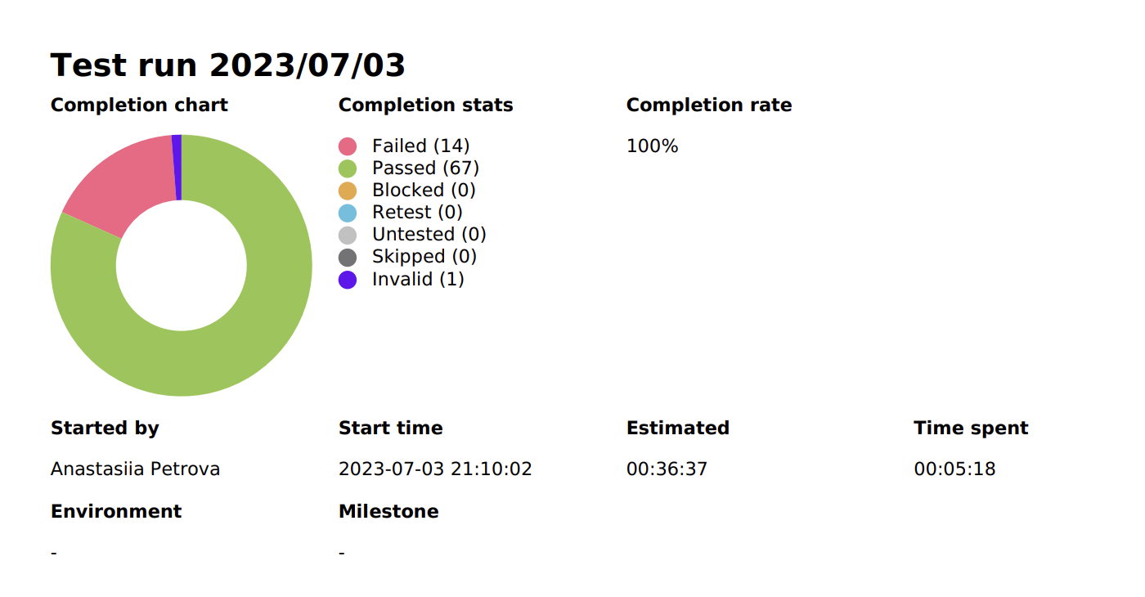
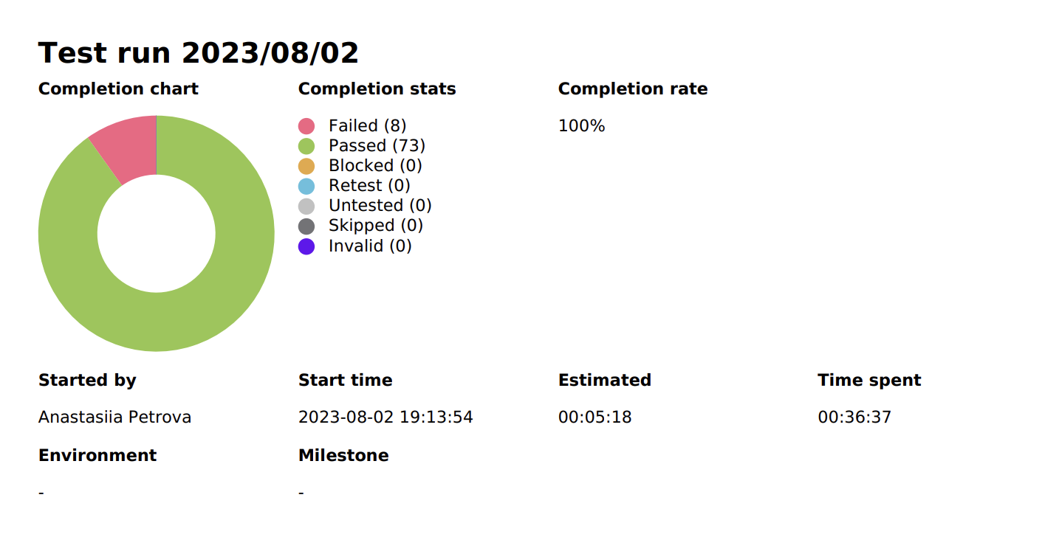
The first version of the website
The second version after fixing bugs

Slide 10
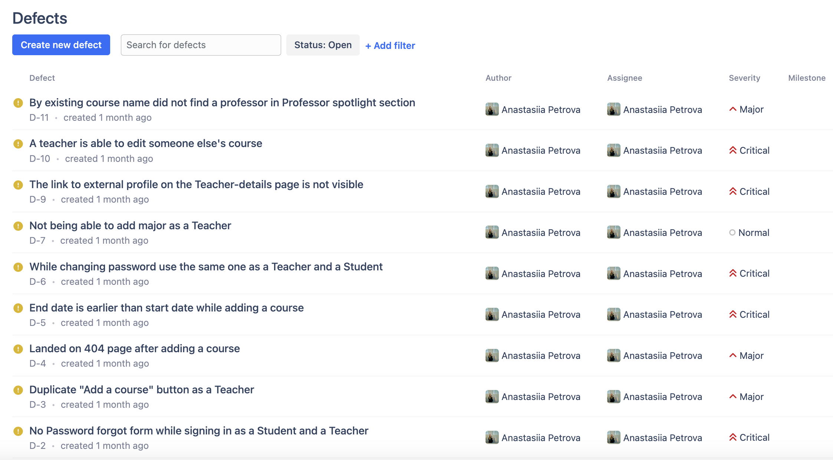

Slide 11
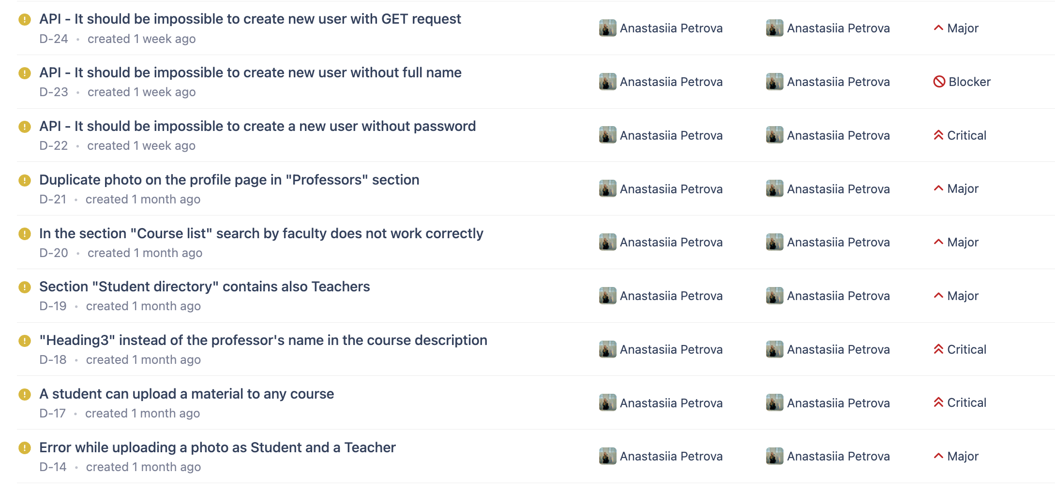

Slide 12
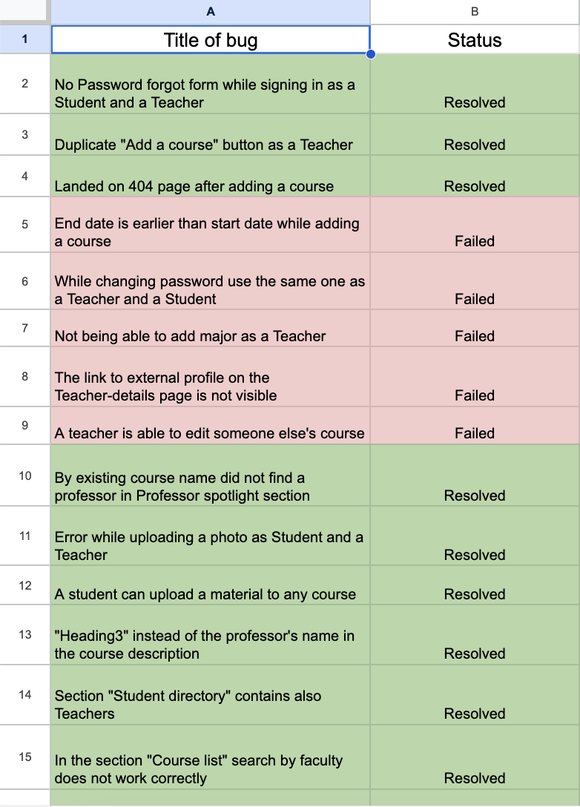
Regression testing of the pre-release version 1.4.1.26

Slide 13
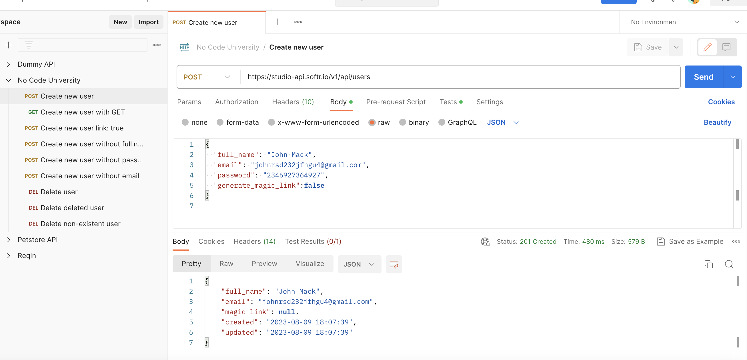

Slide 14
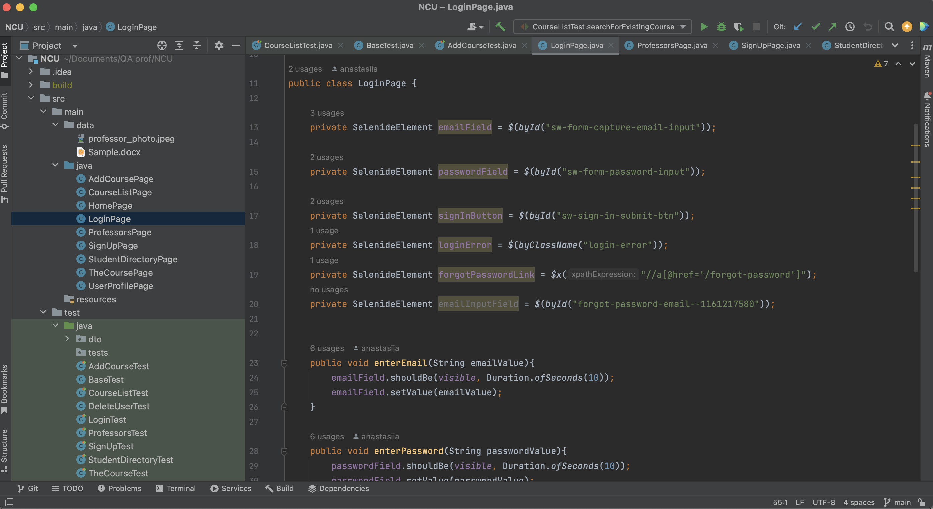

Slide 15
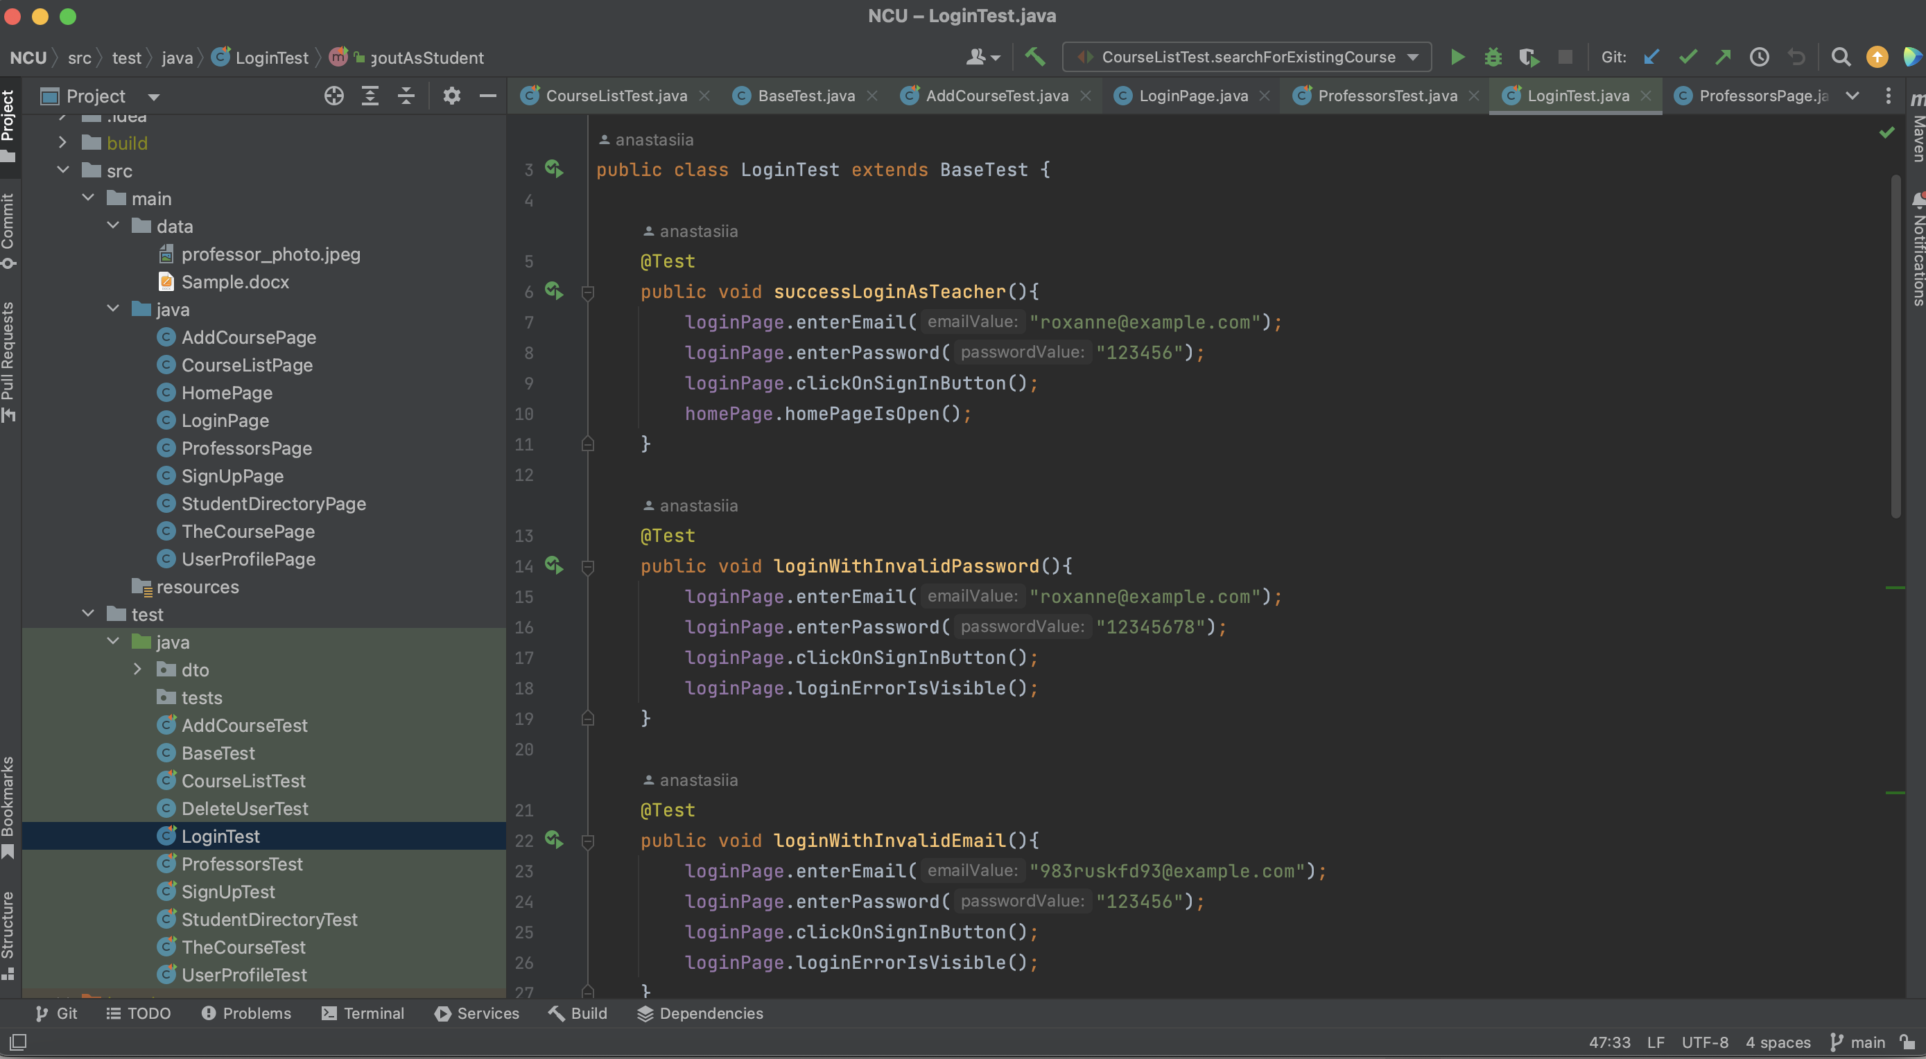

Slide 16
